Slide 1
Secure RESTful Interface Profile Phase 1 Briefing
Mark Russell – Phase 1 Task Lead
July 30, 2014

Slide 2
Background
Sponsor: | Dr. Paul Tibbits, VA Office of Information & Technology (OIT) Architecture, Strategy, & Design (ASD)
Outcome: | Integration with Mission Partners: The VA interoperates seamlessly with mission partners enabled by architectural alignment
Task Area: | Modern Open Architecture Technical contributions to accelerate VA use of open standards and open architectures to successfully serve our nation and facilitate mission partner interoperability
Outcome Lead: | Mary Pulvermacher
VA Task POC: | Joe Paiva / Tim McGrail, ASD Office of Technology Strategies
Task Summary:
Phase 1 - Develop a profile for distributed information sharing using the RESTful architecture style
Use open standards
Must be secure and compliant with VA requirements
Must support lightweight web clients and mobile devices
Phase 2 - Demonstrate the viability of this approach through a pilot deployment

Slide 3
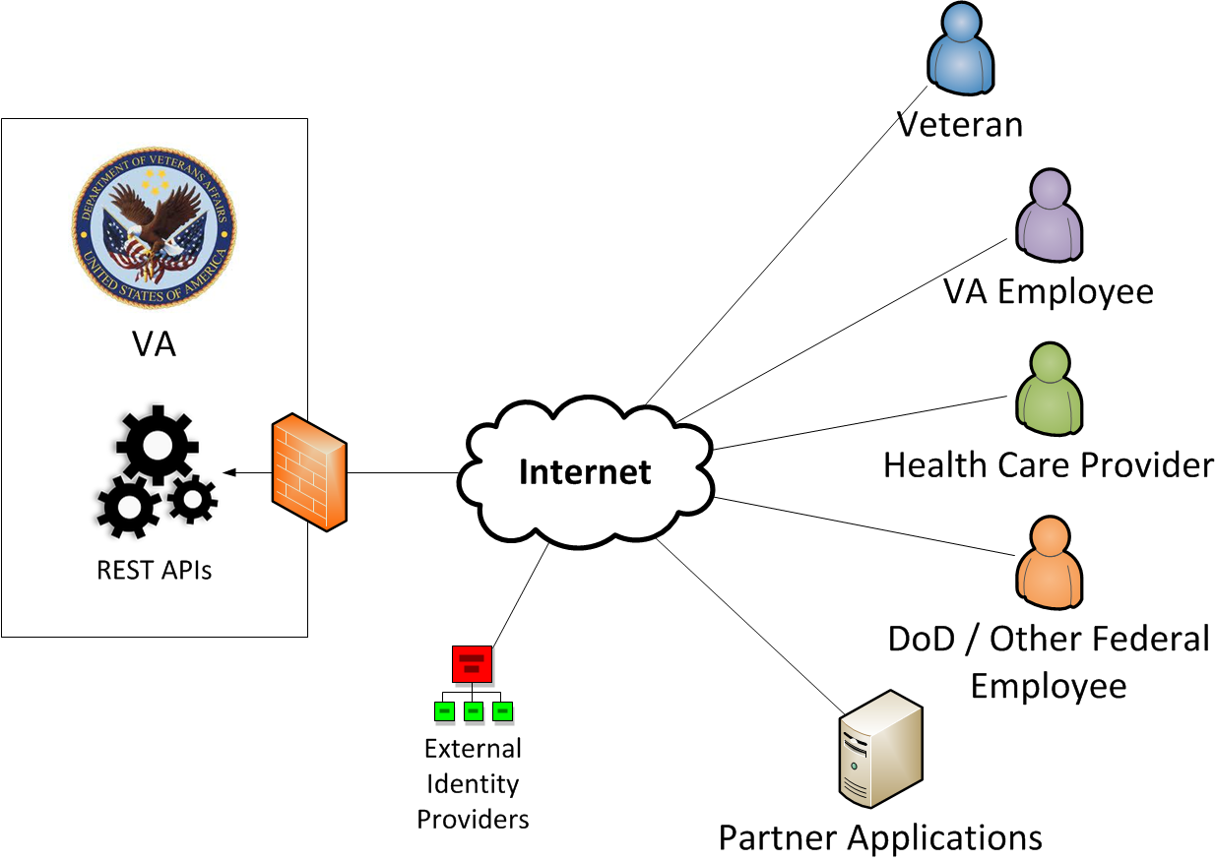
Secure RESTful Interface Profile Scope
How to provide:
Secure Transport
Authentication
Authorization
Across a diverse population of:
Users
.gov/.mil partners
Commercial organizations
Veterans
Citizens
Client software
Web services
Native apps
Browser apps
…For external RESTful Interfaces, using open standards

Slide 4
Scope, continued
Transport Security
Authentication
Authorization
API Design & Content
Not In Scope
In Scope
API content and messaging are not in scope
REST APIs such as HL7 FHIR* do not (and should not) dictate particular security mechanisms
Security elements can be layered over many different APIs serving different kinds of use cases
* Health Level 7 Fast Healthcare Interoperability Resources: http://www.hl7.org/implement/standards/fhir/

Slide 5
Open Security Standards for RESTful Interfaces
A stack of interrelated protocols in wide use on the web can help meet security requirements for RESTful interfaces
UMA (User-Managed Access)
OpenID Connect (Identity Federation)
OAuth (Authorization)
JWT (Secure Tokens)
JOSE
(Signed & Encrypted Data)
TLS (Secure Transport)
JWK
JWS
JWE
JWA
Acronyms:
TLS: Transport Layer Security
JSON: JavaScript Object Notation
JWK: JSON Web Key
JWS: JSON Web Signature
JWE: JSON Web Encryption
JWA: JSON Web Algorithms
JOSE: JSON Object Signatures & Encryption
JWT: JSON Web Tokens

Slide 6
RESTful Security Patterns
The Use Cases document outlines three patterns for REST security:
Client Delegation, using OAuth 2.0
Identity Federation, using OpenID Connect 1.0
VA as Relying Party (RP)
VA as OpenID Provider (OP)
Profiles and security guidance for OAuth and OpenID Connect will be developed to support VA use of these patterns

Slide 7
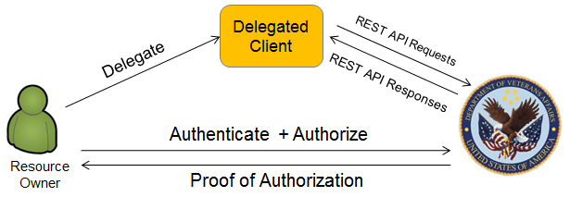
Client Delegation Pattern
Examples:
A veteran delegates access to his/her Electronic Health Record (EHR) to a web application for tracking blood pressure
A veteran delegates access to his/her EHR to a mobile application, limiting the scope of access to information pertaining to a particular medical condition
A veteran uses a personal health monitoring device which uploads measurement data to an external web application; the veteran delegates access to the web service to upload this Patient-Generated Data (PGD) to a VA system

Slide 8
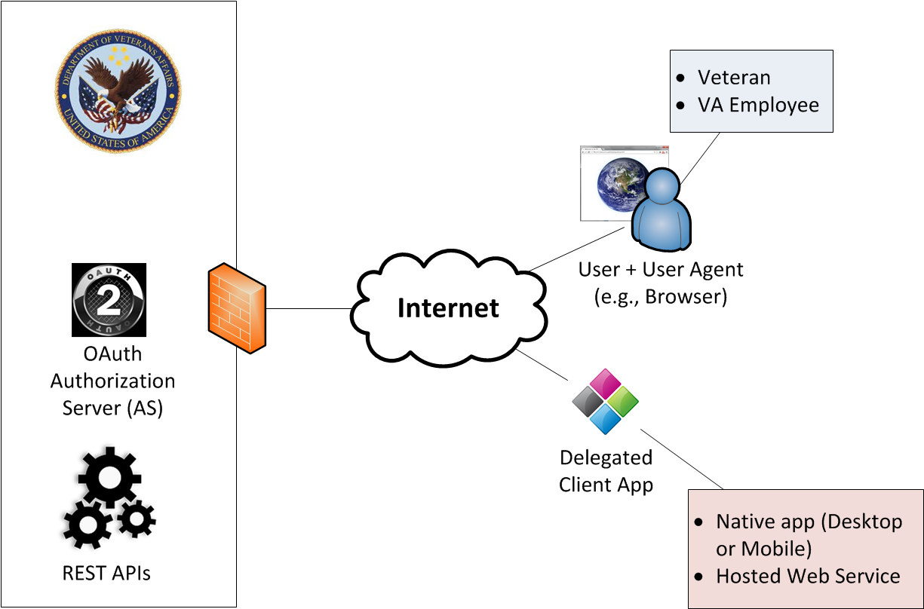
Client Delegation with OAuth 2.0: Authorization Code Flow
Authorization Code Flow
User interacts with client & initiates request for protected resource at VA
Client redirects user agent to AS with authorization request
User authenticates & authorizes client access
OK!
Authorization Server redirects user to Client with an Authorization Code (AC)
Authorization Code
Access Token
Refresh Token
Client submits AC & client credentials to AS’s Token Endpoint
AS validates AC. If valid, AS issues Access Token (AT) and optional Refresh Token (RT)
Access Token
Client accesses Protected REST API, passing AT as proof of authorization
Client can use optional Refresh Token to obtain a new Access Token when AT expires

Slide 9
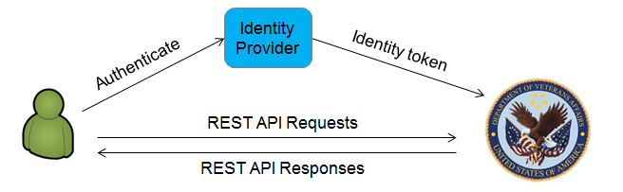
Federation (VA as Relying Party) Pattern
Examples:
A VSO employee authenticates to a VA system through an OP operated by the VSO organization
A specialist authenticates to a VA system through an OP operated by the external health care provider organization in order to view the EHR of a referred patient
A pharmacy employee authenticates to a VA system through an OP operated by the pharmacy to upload veteran immunization records
Veterans authenticate through the OP of their choice as an alternative to DS Logon

Slide 10
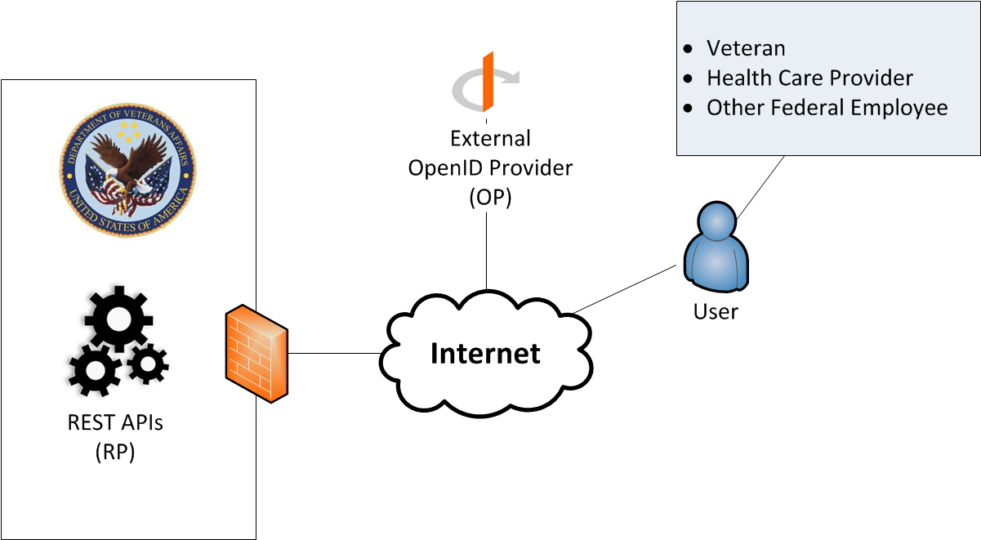
Federation (VA as Relying Party) Pattern: OpenID Connect 1.0
Authorization Code Flow
Unauthenticated user attempts to access protected resource at VA
VA Relying Party (RP) redirects user to OpenID Provider’s (OP) Authorization Server (AS) with an Authentication Request
OK!
Access Token
Authorization Code
User authenticates to AS & authorizes the RP to access identity information
ID Token
AS redirects user to RP with an Authorization Code (AC)
RP authenticates to the OP and submits the Authorization Code
OP validates Authorization Code and issues ID Token and Access Token
RP extracts user identity and other claims from ID Token
If additional claims are needed, RP requests them from OP using the Access Token for authorization

Slide 11
OAuth Attack Categories and Countermeasures
Attack Category | Countermeasures
Extracting credentials or tokens in captured traffic | TLS encryption
Impersonating authorization server or resource server | TLS server authentication
Manufacturing or modifying tokens | Issue tokens as signed JWTs
Redirect manipulation | Require clients to declare redirect URIs during registration
Guessing or interception of client credentials | Used signed JWTs for client authentication
Client session hijacking or fixation | Use the State parameter to ensure continuity of client session throughout the OAuth flow

Slide 12
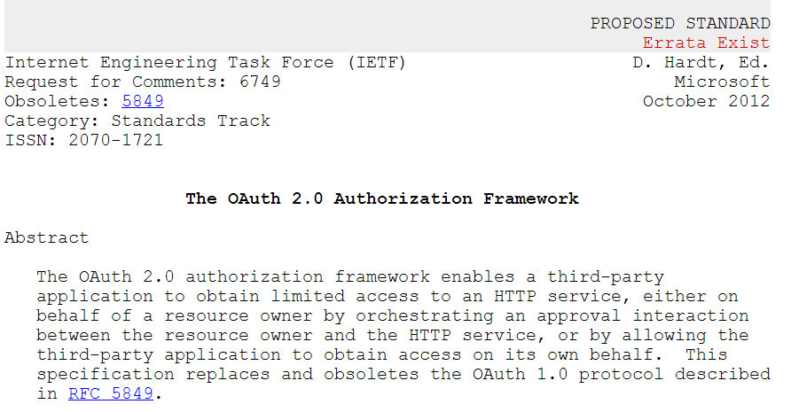
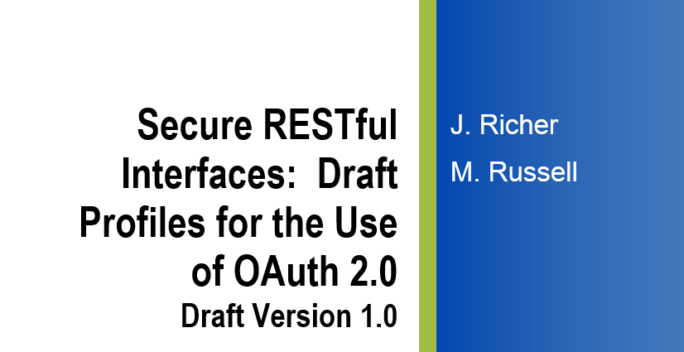
Profiling Security Standards – Examples from the OAuth 2.0 Profile
The authorization server SHOULD require all clients to register their
redirection endpoint prior to utilizing the authorization endpoint.
The authorization server SHOULD require the client to provide the
complete redirection URI
An access token is a string representing an authorization issued to the client. The string is usually opaque to the client.
…
Access tokens can have different formats, structures, and methods of utilization (e.g., cryptographic properties) based on the resource server security requirements.
The server MUST issue tokens as JWTs with, at minimum, the following claims…
The access tokens MUST be signed with JSON Web Signature (JWS). The authorization server MUST support the RS256 signature method for tokens and MAY use other asymmetric signing methods.
RFC6749 – The OAuth 2.0
Authorization Framework
Clients using the authorization code or implicit grant types MUST register their full redirect URIs. The Authorization Server MUST validate the redirect URI given by the client at the authorization endpoint using strict string comparison.
Secure RESTful Interface
Profiles for OAuth 2.0

Slide 13
Next Steps
Phase 2 of the Secure RESTful Interface Profile Project
Collaborating with VHA & ONC on potential pilot integration
Next steps towards VA adoption of the profiles and security guidance:
Host additional discussions with VA stakeholders
Sponsor discussions with external parties
Perform technical integration analysis
Plan for client developer support
Define client standards and registration process, and make them transparent
Incorporate REST standards profiles and other guidance into EA
Questions Identified:
Need for common agreement on how to pass authentication context between VA and its partners
Need consensus on assurance requirements for common health use cases
Federal policy regarding system interconnections needs more clarity

Slide 14
Potential Future Work
Advanced OAuth security options identified in the OAuth profile
Client authentication to protected resources, proof of possession tokens
User-Managed Access (UMA)
Promising protocol for patient consent management – technology not quite ready for production use, but actively being pursued by ONC
Feasibility of including this in Phase 2 pilot activities is in question

Slide 15
Backup Slides

Slide 16





Approach
Inputs
Task Work
Products
Use Cases and Distributed Security Requirements
Approach Briefing
Standards Profiles
Pilot Implementation
Secure RESTful Interfaces Profile
VA Security Policies
PHASE 1
Identify use cases
Analyze requirements
Define standards profiles
Document security guidance
Standards Documents
PHASE 2
Identify pilot use case(s)
Coordinate implementation with VA
Implement pilot
Update documents based on lessons learned
Ongoing Collaboration & Feedback
Existing Profiles
BlueButton+

Slide 17
Secure RESTful Interface Profile Work Products
Secure RESTful Interfaces: Business-oriented Use Cases & Associated Distributed Security Requirements (5/16/14)
Describes three RESTful Security patterns with relevant use case examples
Describes a potential future pattern based on User-Managed Access (UMA)
Secure RESTful Exchange Approach Briefing (6/12/14)
Draft Open Standards Profiles (6/30/14)
Profiles of OAuth and OpenID Connect applicable to a wide range of VA use cases
Includes advanced security options for high-assurance use cases
Secure RESTful Interface Profile Security Analysis and Guidance (7/28/14)
Security analysis of OAuth 2.0 and OpenID Connect 1.0
Rationale for profiling decisions
Analysis of applicable VA and Federal policies and potential impacts
Next steps and identified issues

